Slide 1
Ranking Tasks: PV Diagrams

Slide 2
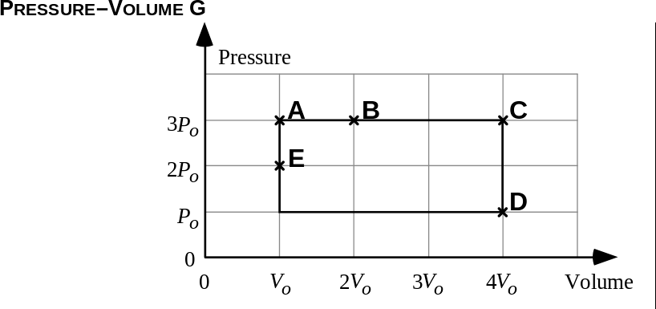
Rank the following from least to greatest Temperature:
On a scale of 0-10, how confident are you?
(0=guessed, 10=100% confident)

Slide 3
In Which Process is the greatest amount of work done?:
Choices:
A→B
B→C
C→D
D→E
On a scale of 0-10, how confident are you?
(0=guessed, 10=100% confident)

Slide 4
Derive an Expression for the number of molecules in the container, using Po, Vo, Tc, and fundamental Constants.
On a scale of 0-10, how confident are you?
(0=guessed, 10=100% confident)

Slide 5
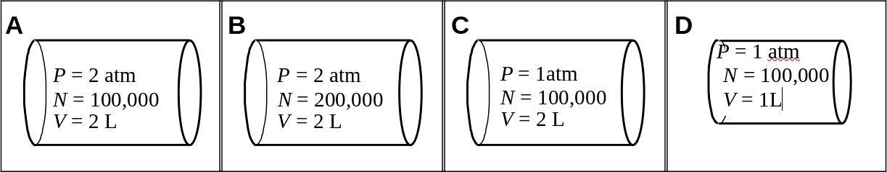
Rank the following from least to greatest Temperature:
On a scale of 0-10, how confident are you?
(0=guessed, 10=100% confident)

Slide 6
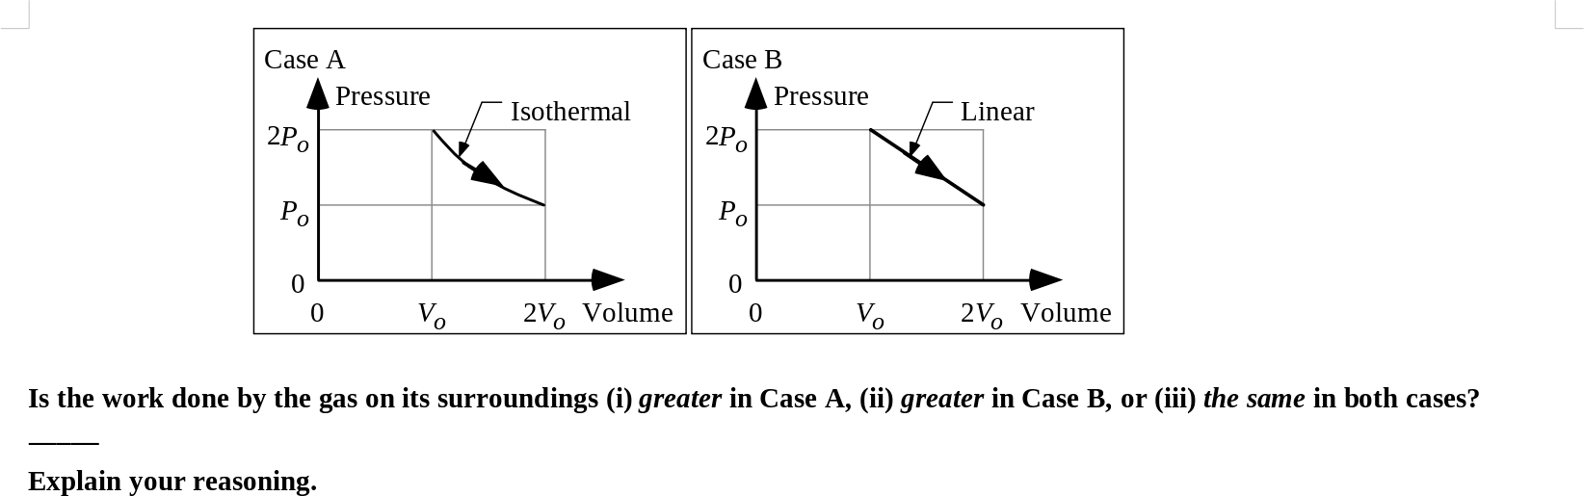
Answer the Question:
On a scale of 0-10, how confident are you?
(0=guessed, 10=100% confident)

Slide 7
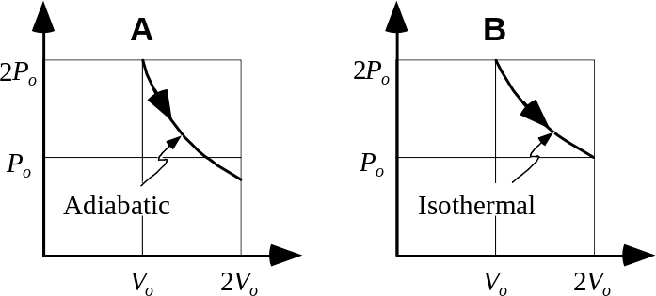
Two identical containers have the same number of molecules trapped in them, and start at the same temperature. In which Process is the final temperature greater?
On a scale of 0-10, how confident are you?
(0=guessed, 10=100% confident)

